Slide 1
Topic: Oxidation (II)
Study Material for M.Sc (P),
Department of Chemistry
Course Name: Methods in Organic Synthesis
Paper Number: 202 Section: B (Group V and VI)
Course Instructor: Dr Trapti Aggarwal

Slide 2
Sharpless Asymmetric Epoxidation
In 1980, T. Katsuki and K. B. Sharpless reported the sharpless symmetric epoxidation
In 2001, the Nobel Prize in Chemistry was awarded to K. Barry Sharpless "for his work on chirally catalysed oxidation reaction.
The Sharpless epoxidation is used for converting steroselectively allylic alcohol to an epoxy alcohol using a titanium isopropoxide catalyst, t-butyl hydroperoxide (TBHP), and a chiral diethyl tartrate (DET).

Slide 3
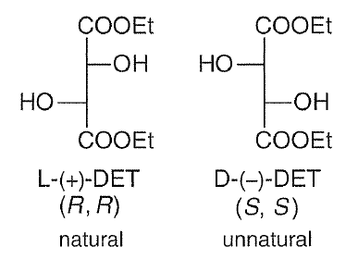
The mechanism initiates with the displacement of the isopropoxide ligands on the titanium by DET, TBHP, and finally by the allylic alcohol reagent.
Diethyl tartrate, the allylic alcohol, and the oxidant t-BuOOH displace the isopropoxide groups on titanium to form the active Ti-catalyst in a complex ligand exchange pathway
Sharpless proposed that oxygen transfer occurs from a dimeric complex that has one tartaric ester moiety per titanium atom.

Slide 4
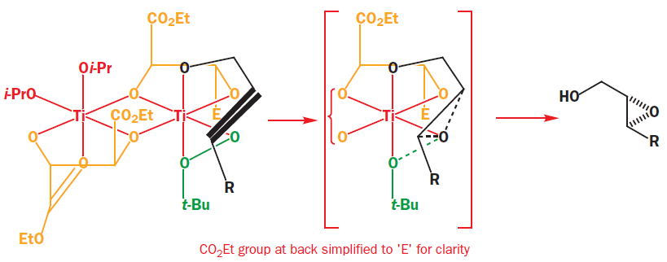
When the oxidizing agent (t-BuOOH), is added to the mixture, it displaces one of the remaining isopropoxide ligands and one of the tartrate carbonyl groups.
Because of the shape of the complex the reactive oxygen atom of the bound hydroperoxide has to be delivered to the lower face of the alkene and the epoxide is formed in high enantiomeric excess.

Slide 5
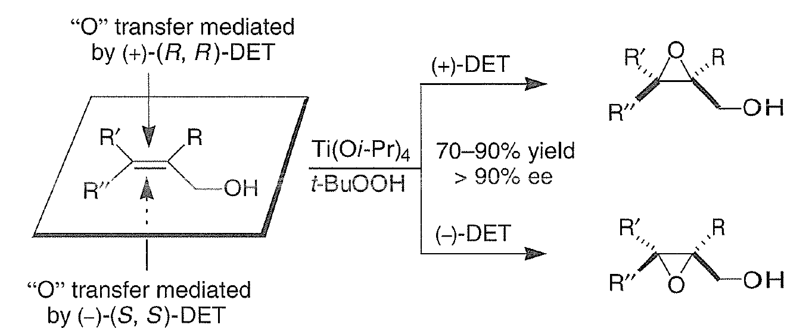
Enantioselectivity in the Sharpless asymmetric epoxidation

Slide 6
Reactions
1
2
3
4

Slide 7
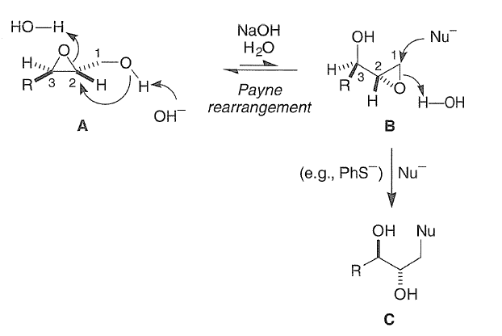
5
The Payne rearrangement is the isomerization, under basic conditions, of 2,3-epoxy alcohols to isomeric 2,3-epoxy alcohols with inversion of configuration.

Slide 8
Reactions

Slide 9
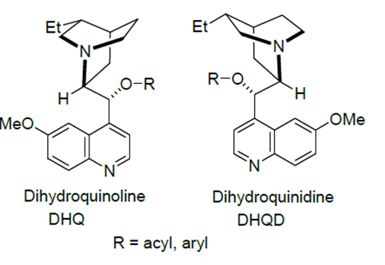
Sharpless Asymmetric Dihydroxylation
Catalytic amount of OsO₄ can be used along with an oxidizing agent, for the conversion of alkene to racemic product.
Sharpless group solve this problem by adding chiral substrate to the osmylation reagents, with the goal of producing a chiral osmate intermediate. The most effective chiral additives were found to be the cinchona alkaloids, such as DHQ and DHQD.

Slide 10
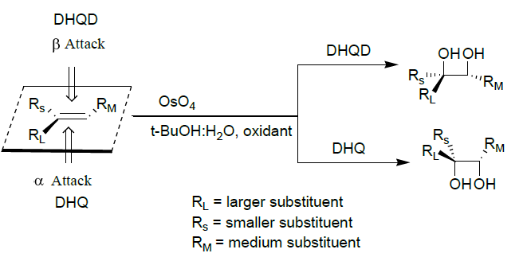
Asymmetric Dihydroxylation
The natural dihydroquinidine (DHQD) ester forces delivery of the hydroxyls from the top face
Dihydorquinine (DHQ) esters deliver hydroxyls from the bottom face

Slide 11
Aminohydroxylation
Similar to cis-1,2-dihydroxylation, in this process, alkene reacts with chloroamine in the presence of OsO₄ to give sulfonamides that is readily converted into the cis-1,2-hydroxyamines by cleavage with sodium in liquid ammonia but the major problem is the poor regioselectivity for unsymmetrical alkenes.
Mechanism

Slide 12
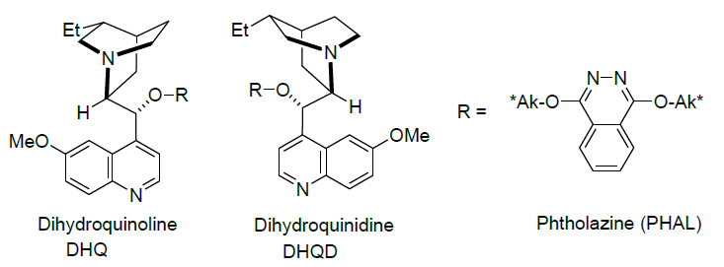
Asymmetric Aminohydroxylation
The asymmetric cis-1,2-aminohydroxylation of alkenes with chloroamine has been explored using the chiral osmium catalyst derived from OsO4 and cinchona alkaloids, dihydroquinidine ligands (DHQD)₂-PHAL and dihydroquinine ligands (DHQ)₂-PHAL.

Slide 13
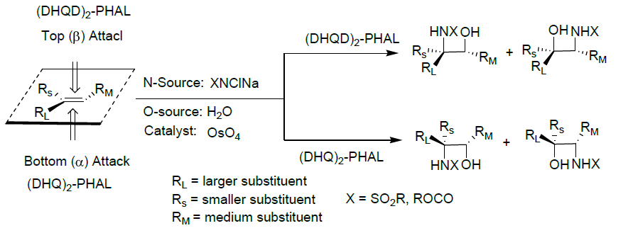
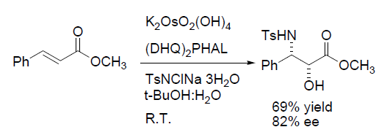
Reactions
1
2

Slide 14
The usual selectivity of the Asymmetric Dihydroxylation reaction in described as: DHQD-based ligands will direct OsO₄ to dihydroxylate from the top face of the double bond and DHQ-based ligands will direct it to dihydroxylate the bottom.
The reason for this must, interaction of the substrate with the osmium–ligand complex.
The ligand forms the chiral pocket’, like an enzyme active site, with the osmium sitting at the bottom of it.and alkenes can only approach the osmium if they are correctly aligned in the chiral pocket.
The analogy with an enzyme active site goes even further, since it appears that part of the pocket is ‘attractive’ to aromatic or strongly hydrophobic groups. This part appears to accommodate R_{L}, which may leads to the selectivity in the dihydroxylation of trans-stilbene.

